Slide 1


Python-Assisted
Red Teaming Operation
Cyber Sec
Pycon Indonesia 2019

Slide 2




About Us
Hi!
Satria Ady Pradana
Cyber Security Consultant of Mitra Integrasi Informatika
Penetration Tester, Red Team
IoT / OT Cyber Security Special Interest Group
Community Leader of Reversing.ID
Love Low-Level Stuffs
xathrya
xathrya
@xathrya

Slide 3


About Us
Hi!
M. Dzikri Ramdhani
Cyber Security Consultant of Mitra Integrasi Informatika
Penetration Tester, Red Team
Reverse Engineering addict
Python Lover
Love Low-Level Stuffs
@mr_dzikri
HadrianCorbett

Slide 4
Cyber Sec
We are not going to teach you Python programming.
We are going to show you the power of python! ❤

Slide 5
Agenda
Introduction to Red-Teaming
What is Red-Teaming? What it need? How effective can it be?
Tactics, Techniques, and Procedures
Successful attack comes from strategic plan.
01
02
Offensive Python
How to train your Python .. For doing dirty job.
04
03
Security loves Python
Python bytes, but we still love.

Slide 6
First, A Story
It’s fictive, of course!

Slide 7

Cyber Sec
Own a store in marketplace.
Trusted store with hundred transactions each day.
Marketplace is secure, comply to various security standards.
Budi activated 2 Factor Authorization (2FA).
OTP will be sent to his mobile phone each time he login.
This morning, an OTP Is coming when he was sleeping.
Budi’s account got hacked!!
Money got stolen from his account.
This is Budi
What possibly can be wrong?
Notes:
How do you prepare for the unexpected?

Slide 8
Introduction to Red Teaming
“Attack is the secret of defence; defence is the planning of an attack”
- Sun Tzu

Slide 9
Red Teaming
Originate from military practices.
Evaluate security posture by playing as aggressor.
Full-scope, multi-layered attack simulation designed to measure how well organization’s security controls can withstand attack from real-life adversaries.

Slide 10
Requirements
Deep knowledge of systems (computer system, protocols, libraries, etc).
Ability to think outside the box.
Software development skills.
Penetration testing skills
Social engineering.

Slide 11
Red Team vs Pentest
Red Team
Penetration Test
Act as enemy
Entire environment is within scope.
Goal is to penetrate (as deep as possible), maintain persistence, pivot, exfiltrate assets.
No special act.
Scope is limited to certain extent.
Goal is to prove exploitation can happen.

Slide 12
Tactics, Techniques, Procedures
Inside the mind of Threat Actor

Slide 13
Tactics Outline the way adversary choose to carry out attack from beginning to the end. Describing the way threat actor operate during different steps of operation / campaign.
Techniques Technological approach of achieving intermediate results during campaign.
Procedures Special sequence of actions used. Highly detailed description in the context of techniques.

Slide 14
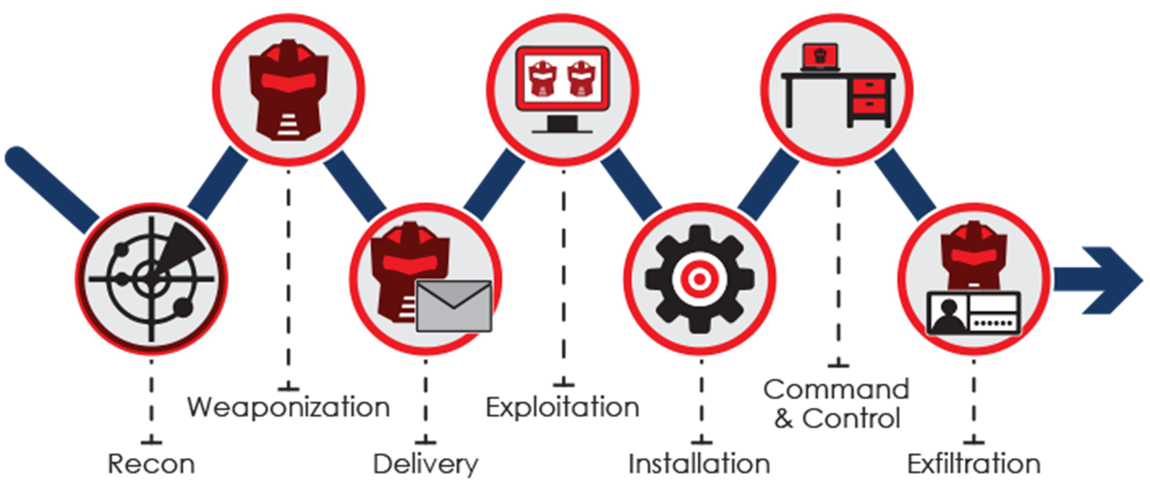
The Cyber Kill Chain
Notes:
Various stages of cyber attack, from early reconnaissance to completion of goal.

Slide 15
Highlight on Infrastructure
Provide reliable communication for long term campaign.
Obfuscate and masquerade to sufficiently avoid detection.
Flexible, adapt to priority or goals.

Slide 16
Cyber Security ❤ Python
Packet crafting reverse engineering
Penetration testing machine learning
Cyber Security Forensic
Automation Exploit Development
Fuzzing
.
.
.
“Python bytes!”

Slide 17
Why Python for cyber security?
Designed for rapid prototyping
Simple and clean structure, improve readability and ease of use.
Extensive library, also ease of interfacing
Widely adopted, most linux distro ship it by default *
Which makes it ideal language for scripting and rapid development.

Slide 18
Tools? Use Python!
Many essential tools are written in Python.
Many tools scriptable with Python.
Not satisfied? Write your own tools.

Slide 19
Case: Basic Networking
Server
Client
Host some files
Collect data
Relay information
Common: HTTP, FTP, SMB
Create (malicious) requests
Scraping
Probing

Slide 20
Case: Basic Cryptograpy
Encrypt & Decrypt
Compute hash value
Some stuffs on digital certificate

Slide 21
Offensive Python
Using Python for Red-Team Operations.

Slide 22
Where is Python?
Attack & Exploitation
Conducting or supporting the attack.
Infrastructure Preparation
Good infrastructure for long-term and series of attacks.
Miscellaneous
Not-directly used for attack but still useful.

Slide 23
Infrastructure Preparation
Deliver payloads
Active Exploitation
Controlling nodes
Receive results
Every part of campaign might need infrastructure.
Programmatically deploy infrastructure for engagements.

Slide 24
Common Infrastructures
Command & Control Servers
Payload Server
Phishing Servers
Redirectors
Should we create dedicate infrastructure?
Server or serverless?

Slide 25
Phishing Servers
Orchestrate SMTP servers with good reputations
Scheduling mail deliveries, coordinated with multiple available SMTP servers.
DKIM, DMARC, SPF, etc… etc...
Python way?

Slide 26
Redirectors
Achieve resilience and concealment by having set of “proxy” in front of assets.
Common types:
SMTP
Payloads
Web traffic
C2 (HTTP/HTTPS, DNS, etc)
Python way?

Slide 27
Infrastructure Setup
DomainHunter (https://github.com/threatexpress/domainhunter)
Hunt expired domains for categorization / reputation

Slide 28
Attack & Exploitation
Attack machine and human.
Deliver malicious code to potential victims:
Reconnaissance
Weaponization
Delivery
Command & Control
Lateral Movement
Network penetration:
Reconnaissance
Exploitation
Red-Team iterate these over and over.

Slide 29
Reconnaissance
Active or passive intelligence gathering.
Gathering:
Assets (machine, application).
Identity.
Document.
Metadata.
Map and classify.

Slide 30
Scanning, Probing, Enumerating
Scapy (https://scapy.net/)
Packet manipulation and decoder.
Send, sniff, dissect, and forge network packets.
OpenDoor (https://github.com/stanislav-web/OpenDoor)
Directory scanner
Make it async?! Sure!

Slide 31
Wfuzz (https://github.com/xmendez/wfuzz/)
Web fuzzer framework
Pyfuzz (https://github.com/AyoobAli/pyfuzz)
URL fuzzing tool
Fuzzing to discover hidden files/directories

Slide 32
OSINT with Python
Recon-NG (https://github.com/lanmaster53/recon-ng)
Reconnaissance framework for powerful environment to conduct open source web-based reconnaissance.
Belati (https://github.com/aancw/Belati)
Collecting public data & public document from website and other services.
Pwndb (https://github.com/davidtavarez/pwndb)
Search leaked credentials.
Python + Shodan API
With Machine Learning? Sounds good

Slide 33
Weaponization
There are many CVEs
Create python script for generate payload based on public disclosure.

Slide 34
Delivery
CredSniper (https://github.com/ustayready/CredSniper)
Phishing framework on top of micro-framework.
Supports capturing 2FA tokens.

Slide 35
Command & Control – Remote Access
Empire (https://github.com/EmpireProject/Empire)
Post exploitation framework.
Pure-PowerShell 2.0 agent for Windows
Pure Python 2.6 / 2.7 agent for Linux / OS X
SILENTTRINITY (https://github.com/byt3bl33d3r/SILENTTRINITY)
Asynchronous collaborative post-exploitation agent.
Python and .NET DLR

Slide 36
Exploitation
Web application?
Web service?
Network services?
Cloud environment?

Slide 37
Pacu (https://github.com/RhinoSecurityLabs/pacu)
AWS exploitation framework
AWS Pwn (https://github.com/dagrz/aws_pwn)
Collection of AWS penetration testing scripts

Slide 38
CrackMapExec (https://github.com/byt3bl33d3r/CrackMapExec)
Map SMB network, crack credentials, and execute command.
DeathStar (https://github.com/byt3bl33d3r/DeathStar)
Using Empire’s RESTful API to automate gaining Domain Admin in Active Directory.
Responder (https://github.com/SpiderLabs/Responder)
LLMNR, NBT-NS, MDNS poisoner
Built-in HTTP/SMB/MSSQL/FTP/LFAP rogue authentication server.
Answer queries to specific names

Slide 39
Winpayloads (https://github.com/nccgroup/Winpayloads)
Undetectable windows payload generation.
Cloak (https://github.com/s0md3v/Cloak)
Python backdoor framework
Generate payload and inject into python scripts.

Slide 40
Data Exfiltration
PyExfil (https://github.com/ytisf/PyExfil)
Python package for data exfiltration.

Slide 41
Miscellaneous
RedELK (https://github.com/outflanknl/RedELK)
Red-Team’s SIEM tool for tracking and alarming Blue Team activities.

Slide 42
Miscellaneous
Debugging
ImmunityDbg + mona.py
Binary Analysis
Angr (https://github.com/angr/angr)

Slide 43


Slide 44





Thank You
Cyber Sec
Satria Ady Pradana
+62 89 774 239 35
Satria.Pradana@mii.co.id
@xathrya (telegram)

